Slide 1
PC403 B. Tech mini Project
Implementation of OFDM based Transmission System using USRP
04-December-2017
N. Srisai Karthik
201401072@daiict.ac.in
Mentor – Prof. Laxminarayana Pillutla

Slide 2
HONOR PLEDGE
I, Karthik (201401072), hereby declare that
the work that I am presenting is my own work.
I haven’t copied the work (codes, VIs, results, etc.) that someone else has done.
Concepts and insights I will be describing are based on my own understanding.
Wherever I have relied on an existing work that is not my own, I have provided a proper reference citation.
I make this pledge truthfully. I know that violation of this solemn pledge can carry grave consequences.

Slide 3
Presentation OUTLINE
Introduction
Background
Implementation
Simulation Results
Future Work
Summary
Main References
Appendix

Slide 4
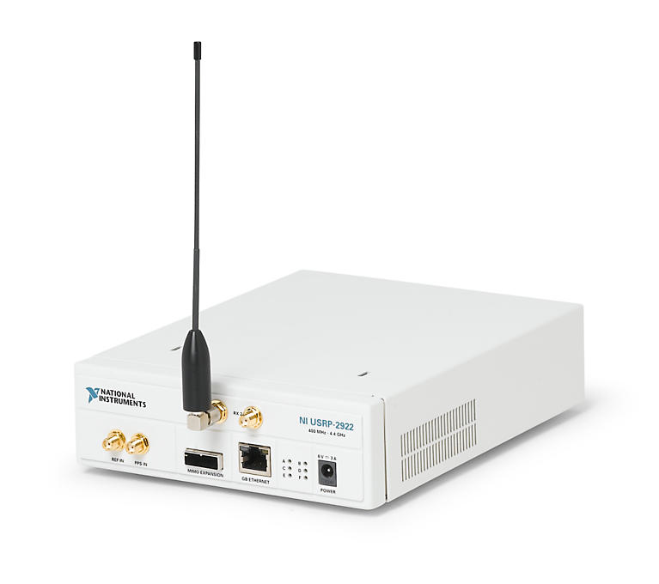
INTRODUCTION
Aim – To implement OFDM based Transmission system using USRP
OFDM – Orthogonal Frequency Division Multiplexing
PHY layer technology
USRP – Universal Software Radio Peripheral
NI USRP 2922, 400MHz to 4.4GHz
using LabVIEW 2015 on Windows 7 PC
Channel Estimation
scattered pilot arrangement
based on Least Squares (LS) method
Source: http://s7d5.scene7.com/is/image/ni/12181203?$ni-card-lg$

Slide 5
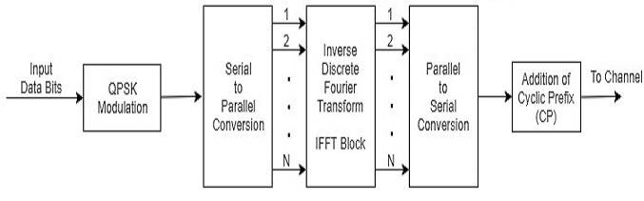
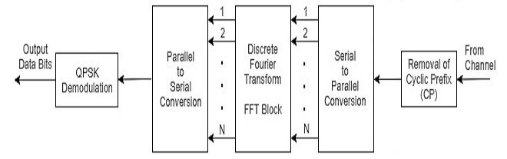
basic OFDM - BLOCK DIAGRAM
OFDM Transmitter
OFDM Receiver

Slide 6
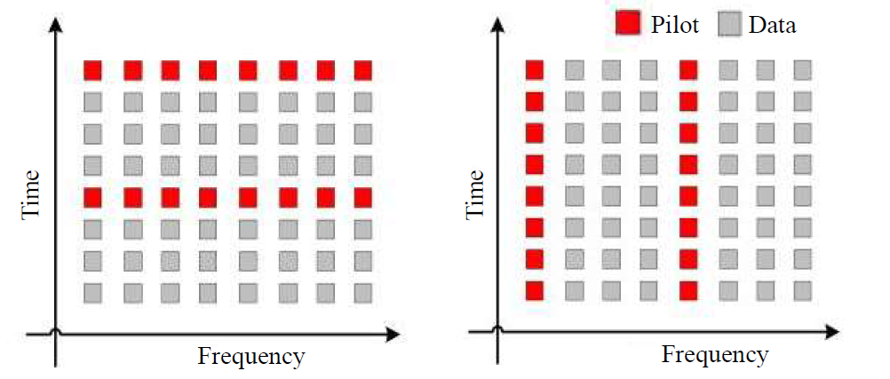
Distribution of pilot tones
Block type (left) and Comb-type (right) Pilot Distributions

Slide 7
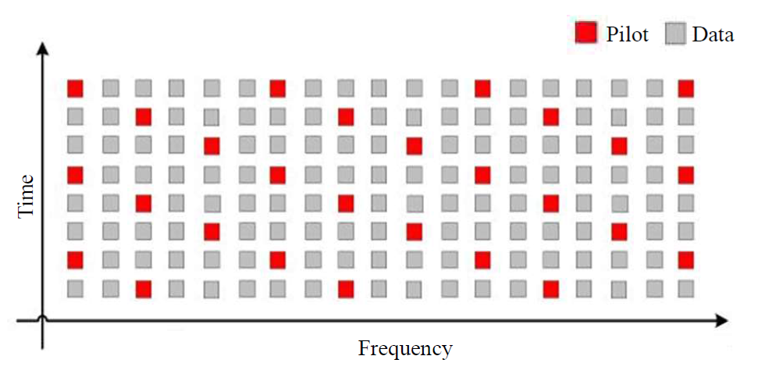
Distribution of pilot tones (contd.)
Scattered Pilot Distribution

Slide 8
IMPLEMENTATION
Simulations performed for -
Controlled Channel Environment
Actual Channel
Controlled Channel
for different number of multipath
simulated in LabVIEW
Actual Channel
implemented using USRP
grayscale image (291x240) is transmitted

Slide 9
OFDM IMPLEMENTATION PARAMETERS
PARAMETER | VALUE
Number of Subcarriers | 256
Data Subcarriers | 180
Pilot Subcarriers | 18
Null Subcarriers | 58
Cyclic Prefix Length | 28
Frame Length | 220 OFDM symbols
Transmission Frequency | 2.422 GHz

Slide 10
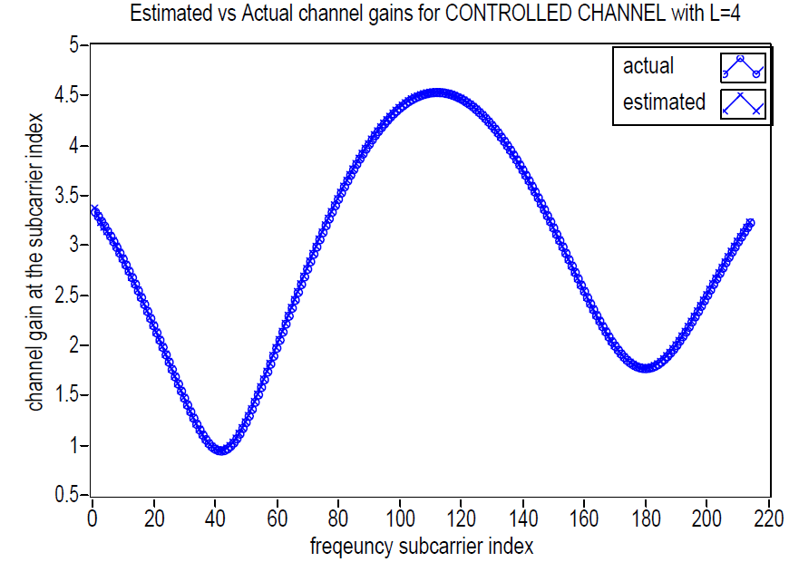
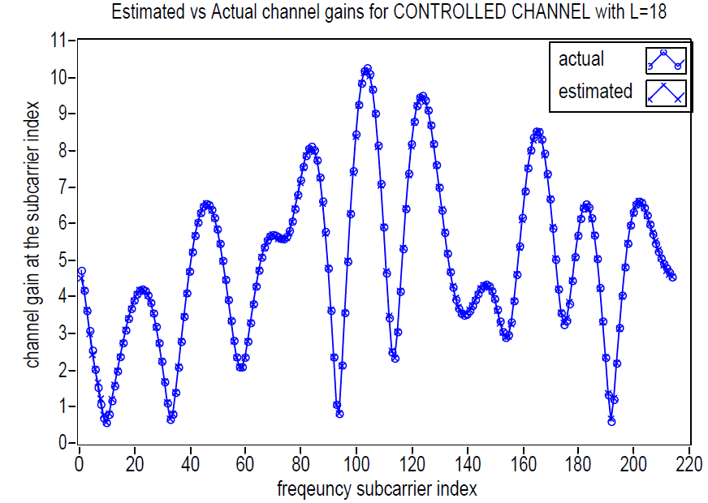
SIMULATION RESULTS - I
Performance of Least Squares based Channel Estimation in terms of estimated channel gains versus actual channel gains across subcarriers for controlled channels with multipath L = 4 and 18 respectively

Slide 11
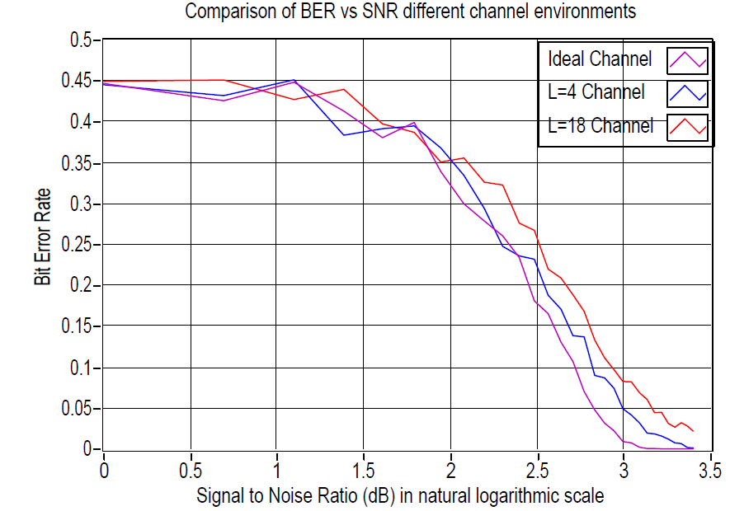
simulation RESULTS - II
BER vs SNR for different channel conditions

Slide 12
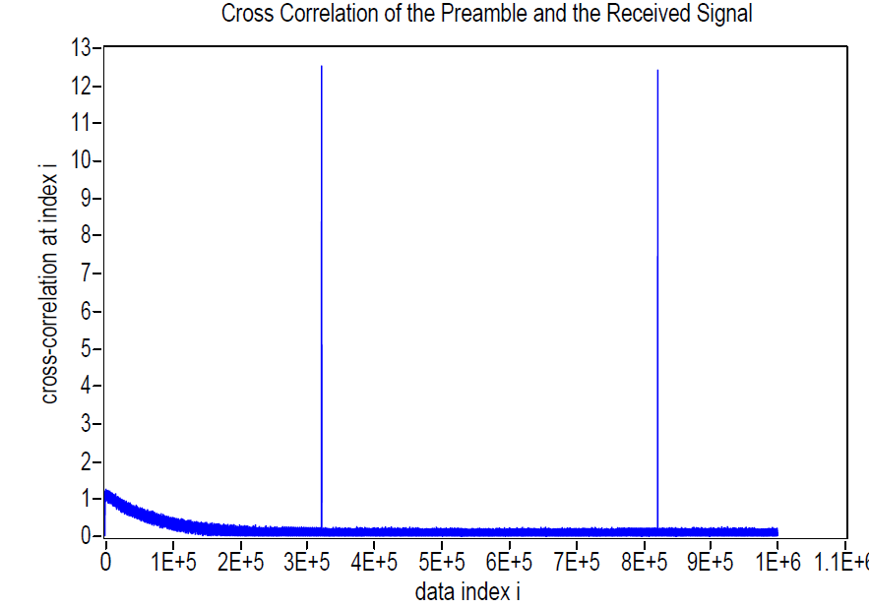
simulation RESULTS - III
Synchronization at the Receiver for transmission using USRP

Slide 13
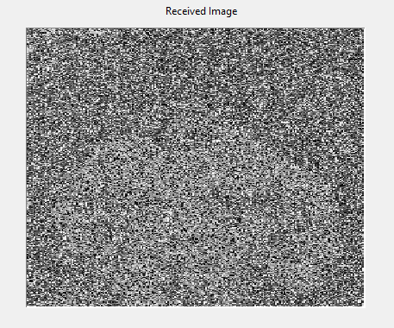
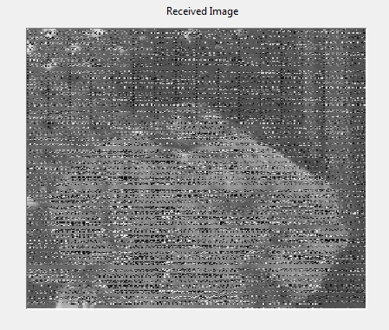
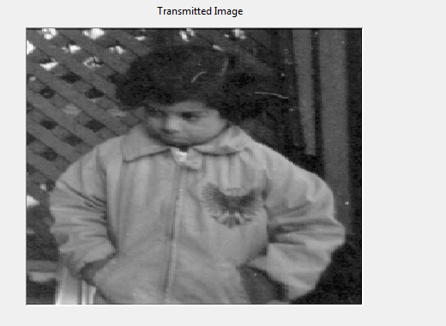
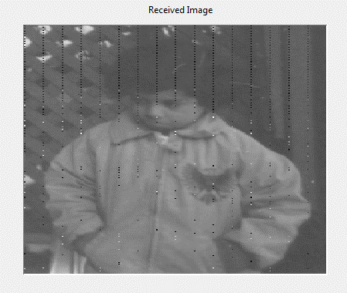

simulation RESULTS - IV
Comparison of the transmitted and received images after transmission across real channel at different SNR
at 5dB
at 15dB
at 25dB
at 30dB

Slide 14
FUTURE WORK
Can be implemented using two USRPs with some distance of separation – there may be multipath fading.
Can be extended to a moving system with a mobile receiver – there may be Doppler effect due to the relative motion.
Channel Estimation can be performed efficiently rather than using a computationally intensive Least Squares method which involves matrix inversion.
Efficient techniques can be developed to both facilitate better synchronization at the receiver and reduce the overhead.

Slide 15
SUMMARY
OFDM - multi carrier modulation technique that pursues transmission over complex exponentials at different frequencies using IDFT.
Advantage of using OFDM is it’s robustness to frequency selectivity of wireless channels and ability to counter Inter Symbol Interference (ISI).
Dynamic estimation of channel is necessary and achieved through insertion of pilot tones into the OFDM symbols before transmission.
Least Squares based channel estimation has been simulated in LabVIEW for different number of multipath.
Performance of synchronization and channel estimation has been analysed for transmission across actual channel using USRP by sending a grayscale image.

Slide 16
MAIN REFERENCES
David Tse and Pramod Viswanath, Fundamentals of Wireless Communication, Cambridge University Press, 2005.
Mohammad H Firooz, Zhiyong Chen, Sumit Roy, and Hui Liu, “Wireless Network Coding via Modified 802.11 MAC/PHY: Design and implementation on SDR,” IEEE Journal on Selected Areas in Communications, vol.31, no.8, pp.1618–1628, 2013.
Sinem Coleri, Mustafa Ergen, Anuj Puri, and Ahmad Bahai, “Channel Estimation Techniques Based on Pilot Arrangement in OFDM Systems,” IEEE Transactions on Broadcasting, vol.48, no.3, pp.223–229, 2002.
Yong Soo Cho, Jaekwon Kim, Won Young Yang, and Chung G Kang, MIMO-OFDM Wireless Communications with MATLAB, John Wiley & Sons, 2010.
Bruce A. Black, Introduction to Communication Systems: A Lab Based Learning with NI USRP and LabVIEW Communications – Student Lab Manual, 2014.

Slide 17
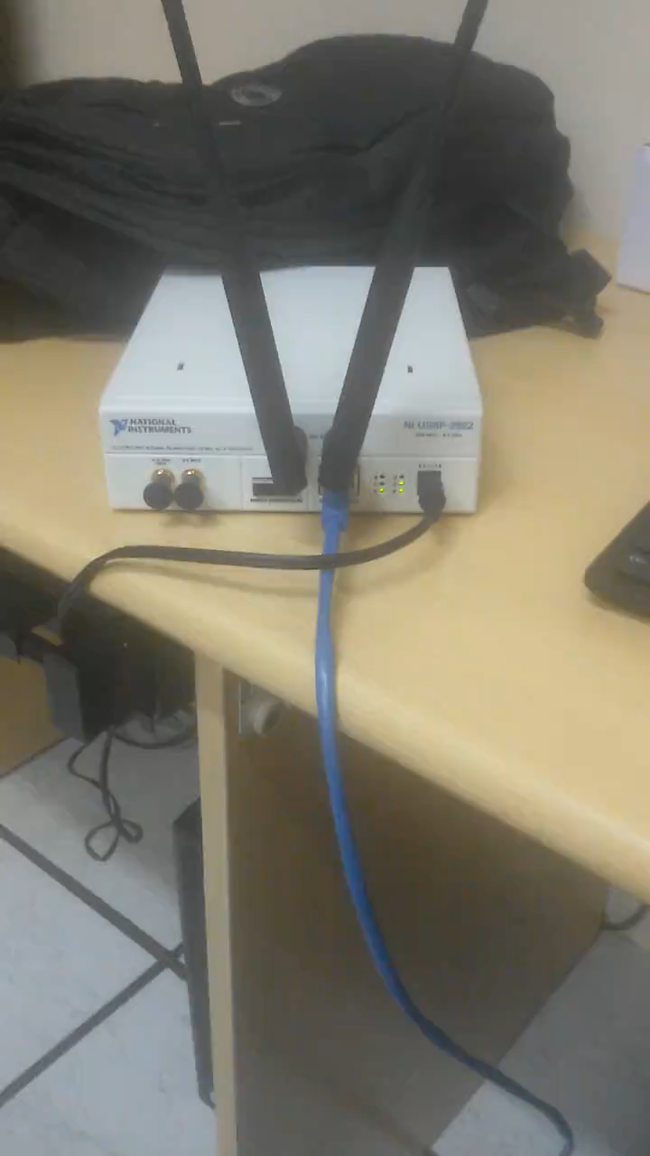
APPENDIX

